Slide 1
Basics of PHP

Slide 2
PHP
PHP (Hypertext Preprocessor) is a server-side scripting language mainly used to create dynamic and interactive web applications.
It is embedded inside HTML and executed on the web server, not in the user's browser.

Slide 3
👉 PHP helps websites perform backend operations such as:
Processing forms
Storing and retrieving data
Creating login systems
Connecting to databases
Managing sessions
Generating dynamic content

Slide 4
Why PHP is Called Server-Side Language?
Because:
✔ PHP code runs on the server ✔ Only output is sent to browser ✔ Original PHP code is hidden ✔ More secure processing

Slide 5
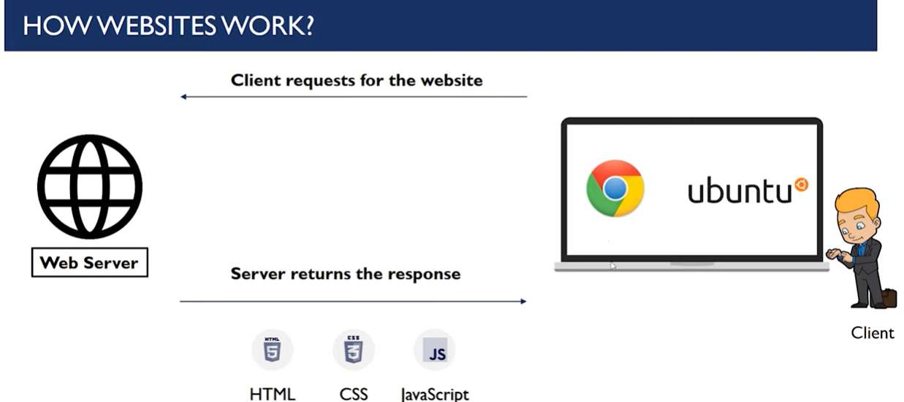

Slide 6
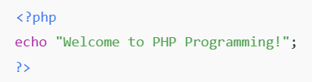

Example of PHP Program
PHP Code:
Output:
👉 Browser receives only the output, not PHP code.

Slide 7
History of PHP
PHP was created by Rasmus Lerdorf in 1994.
At first, PHP was not a programming language. It was a set of small tools used to track visits to Rasmus’s personal website.
Initially PHP stood for:
Personal Home Page
Later, it was renamed to:
PHP: Hypertext Preprocessor

Slide 8
client site script vs server site script
In web development, scripts are divided into two main categories:
👉 Client-Side Script 👉 Server-Side Script

Slide 9
1) Client-Side Script
What is Client-Side Script?
Client-side scripting means the code runs on the user’s browser (client computer).
The browser downloads the script and executes it locally.
✅ Common Client-Side Languages
✔ JavaScript ✔ HTML ✔ CSS

Slide 10
How Client-Side Script Works
Workflow Diagram:
Server
↓ (Sends Code)
Browser (Client)
↓
Script Executes
↓
Result Displayed

Slide 11
Example (JavaScript)
<script>
alert("Welcome User!");
</script>
👉 Runs inside browser 👉 User can see source code 👉 Fast response

Slide 12
✅ Uses of Client-Side Script
✔ Form validation ✔ Button click events ✔ Animations ✔ Interactive UI ✔ Dynamic page effects

Slide 13
Limitations of Client-Side Script
Less secure
No direct database access
Code visible to users
Browser dependent

Slide 14
2) Server-Side Script
What is Server-Side Script?
Server-side scripting means code runs on the web server.
Only the result is sent to the browser.
✅ Common Server-Side Languages
✔ PHP ✔ Python ✔ Java ✔ ASP.NET ✔ Node.js

Slide 15
How Server-Side Script Works
Workflow Diagram:
Browser Request
↓
Web Server
↓
Script Executes
↓
HTML Output
↓
Browser Display

Slide 16
Example (PHP)
<?php
echo "Welcome Server Side!";
?>
👉 Runs on server 👉 Secure 👉 Hidden logic 👉 Can access database

Slide 17
✅ Uses of Server-Side Script
✔ Login systems ✔ Database operations ✔ Payment processing ✔ Authentication ✔ File uploads

Slide 18
Client-Side vs Server-Side (Comparison Table)
Feature | Client-Side Script | Server-Side Script
Execution Location | Browser | Server
Security | Low | High
Database Access | ❌ No | ✅ Yes
Speed | Fast | Slower than client
Code Visibility | Visible | Hidden
User Interaction | UI handling | Business logic

Slide 19
Real Example: Login Page
Client-Side Work (HTML + JS)
✔ Display login form ✔ Validate empty fields ✔ Show error message
Server-Side Work (PHP)
✔ Check username ✔ Verify password ✔ Connect database ✔ Create session

Slide 20
Variables in PHP
A variable in PHP is used to store data that can be used and changed during program execution.
What is a Variable?
👉 A variable is a named container that holds a value.
Example:
$name = “sam";
Here:
$name → Variable name
“sam" → Value stored

Slide 21
Declaring Variables in PHP
Syntax:
$variable_name = value;
Example:
$age = 18;
$price = 99.50;
$isStudent = true;

Slide 22
Rules for PHP Variables
PHP variables must follow these rules:
✔ Must start with $ symbol ✔ Must start with a letter or underscore _ ✔ Cannot start with number ✔ No spaces allowed ✔ Case-sensitive

Slide 23
Valid Variables
$name = "Amit";
$_age = 20;
$totalMarks = 450;

Slide 24
Invalid Variables
$1name = "Ram"; // Wrong (starts with number)
$first name = ""; // Wrong (space not allowed)

Slide 25
Displaying Variables
Use echo or print:
Example:
$name = "Student";
echo $name;
Output:
Student

Slide 26
Variable Data Types
PHP automatically detects data type.
✅ String
$name = "Ravi";
✅ Integer
$age = 21;
✅ Float
$marks = 85.5;
✅ Boolean
$status = true;

Slide 27
Concatenation (Joining Variables)
Use dot (.) operator:
Example:
$fname = "Ram";
$lname = "Kumar";
echo $fname . " " . $lname;
Output:
Ram Kumar

Slide 28
Variable Scope
Scope defines where variable can be used.
🔹 Local Variable
Declared inside function:
function test() {
$x = 10;
}
Only usable inside function.

Slide 29
🔹 Global Variable
Declared outside function:
$x = 20;
Use inside function using global keyword:
function show() {
global $x;
echo $x;
}

Slide 30
🔹 Static Variable
Preserves value between function calls:
function counter() {
static $count = 0;
$count++;
echo $count;
}

Slide 31
Checking Variable Type
Using var_dump():
$age = 25;
var_dump($age);
Output:
int(25)

